Slide 1

HW 10 - Decision Tree
Hemin Patel

Slide 2
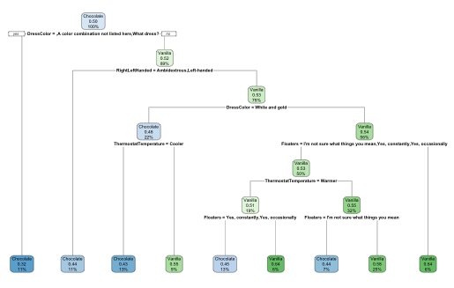
Tree 1
Relative Error:
118/238 = 0.4958
Notes:
# Tree 1: ChocolateOrVanilla
library(rpart)
library(rpart.plot)
tree1 <- rpart(ChocolateOrVanilla ~ DressColor + Floaters + RightLeftHanded + ThermostatTemperature, data= anon, method="class")
rpart.plot(tree1)
printcp(tree1)
# Root node error: 118/238 = 0.4958
#
# n= 238
#
# CP nsplit rel error xerror xstd
# 1 0.059322 0 1.00000 1.0593 0.065287
# 2 0.025424 1 0.94068 1.0763 0.065222
# 3 0.016949 2 0.91525 1.1525 0.064699
# 4 0.010593 4 0.88136 1.1102 0.065036
# 5 0.010000 8 0.83898 1.1102 0.065036

Slide 3
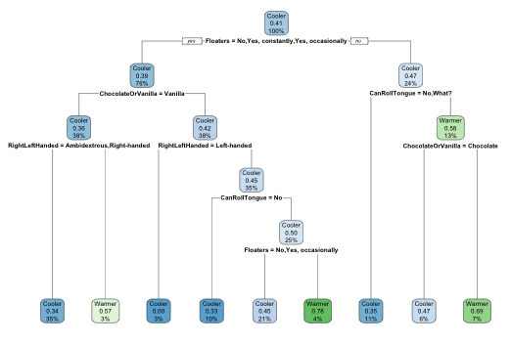
Tree 2
Relative Error:
97/238 = 0.40756
Notes:
# Tree 2: ThermostatTemperature
library(rpart)
library(rpart.plot)
tree2 <- rpart(ThermostatTemperature ~ RightLeftHanded + Floaters + ChocolateOrVanilla + CanRollTongue, data= anon, method="class")
rpart.plot(tree2)
printcp(tree2)
# Root node error: 97/238 = 0.40756 #low error, good
#
# n= 238
#
# CP nsplit rel error xerror xstd
# 1 0.025773 0 1.00000 1.0000 0.078151
# 2 0.012887 2 0.94845 1.0928 0.079046
# 3 0.010309 6 0.89691 1.0928 0.079046
# 4 0.010000 8 0.87629 1.0103 0.078274

Slide 4
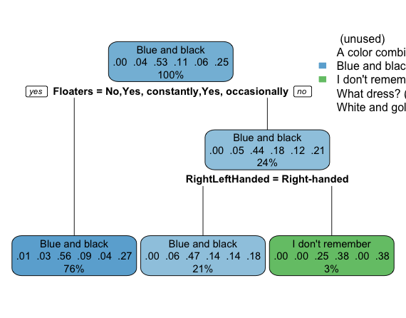
Tree 3
Relative Error:
111/238 = 0.46639
Notes:
# Tree 3: DressColor
library(rpart)
library(rpart.plot)
tree3 <- rpart(DressColor ~ Floaters + RightLeftHanded + ChocolateOrVanilla + CanRollTongue, data= anon, method="class", cp=0.001)
rpart.plot(tree3)
printcp(tree3)
# Root node error: 111/238 = 0.46639
#
# n= 238
#
# CP nsplit rel error xerror xstd
# 1 0.0045045 0 1.00000 1.000 0.069335
# 2 0.0010000 2 0.99099 1.036 0.069453

